Slide 1
IUC-project
ARU - Tanzania
Em. prof. ir. Rob Cuyvers
Prof. dr. Gabriel Kassenga

Slide 2

^{1 story, 5 lines}
Why Tanzania/ARU?
What is the focus of this IUC-project?
How was the project developped?
What next?
Wich are the shared aspirations?

Slide 3
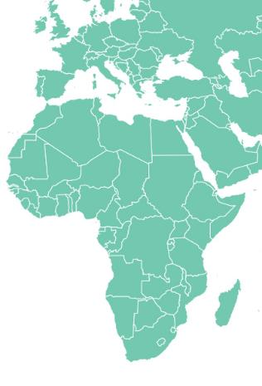
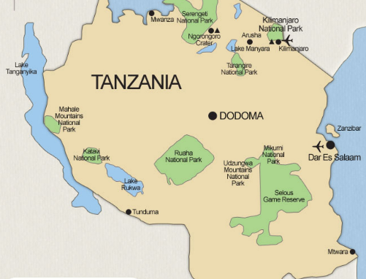


Slide 4

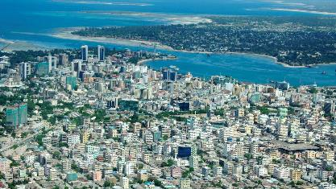
Dar es Salaam

Slide 5
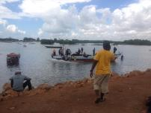
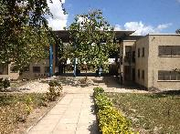
^{Why Tanzania/ARU?}
Longterm cooperation
How this cooperation started
  South Initiative (VLIR-UOS)
  Ecotourism at the coastline (2014-2016)
ARU wants to build capacity in research and advanced education
ARU is a reliable and competent partner

Slide 6


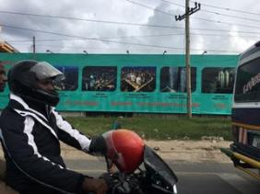
^{What is the focus of the IUC}
15 most growing cities worldwide are situated in Africa
Dar Es Salaam worldwide 2nd on this ranglist
2020: 6M inhabitants 2030: 10M inhabitants (megacity)

Slide 7
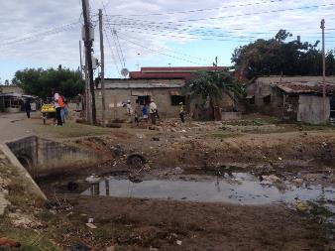
Growth in Dar Es Salaam is unlimited
75% are ‘informal settlements’
Enormous problems
  Planning
  Decent housing
  (water/energy/sustainable building)
  Mobility
  Socio-economic development
  Cultural heritage
  …

Slide 8

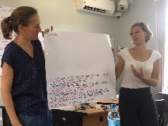
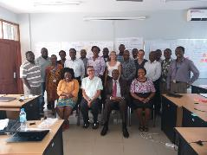
^{Building up a project}
Start: workshop Dar Es Salaam
Afterwards: many, many mails, phone calls, meetings …

Slide 9
Challenge: sustainable urban development in a fast growing city
SDG 11 as a framework (‘Domains of Change’)
All Flemish Universities + University college PXL
The African Centre for Sustainable Cities Studies (ACS)
Three pilot sites

Slide 10
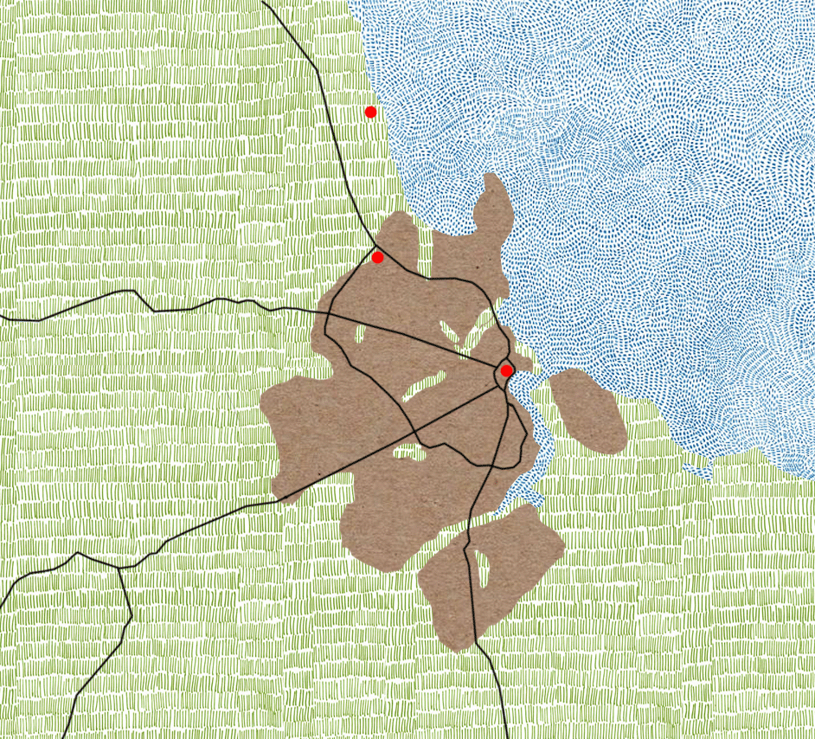

Slide 11
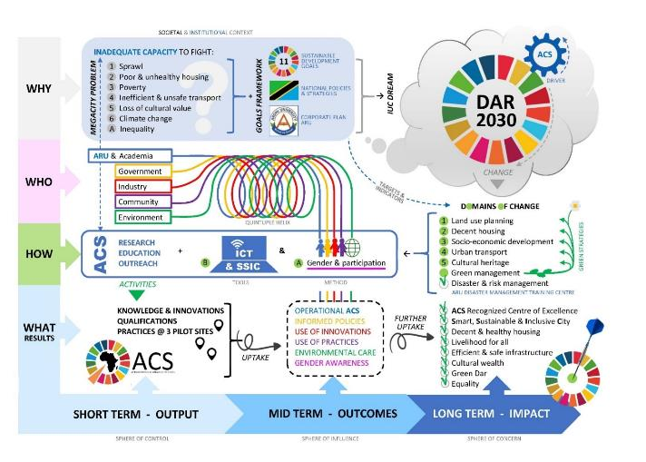

Slide 12

Domains of change
5 PROJECTS
  1 | Land Use Planning (Oswald Devisch, UHasselt)
  2 | Decent Housing (Patrick Willems, KU Leuven)
    Water Management (Patrick Willems, KU Leuven)
    Energy (Wim Deferme, UHasselt)
    Building Methods/Materials (Elke Knapen, UHasselt)
  3 | Socio-Economic Development (Joost Dessein, UGent)
  4 | Urban Transport (An Neven, UHasselt)
  5 | Cultural Heritage (Koenraad Van Cleempoel, UHasselt)

Slide 13
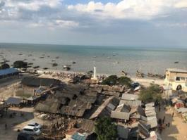
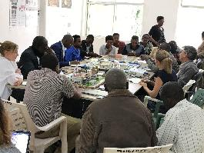
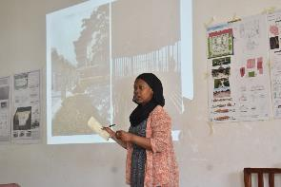
  1 | Gender and Participation (Nathalie Holvoet, UAntwerpen)
  2 | Smart Sustainable and Inclusive Cities (SSIC) (Leo Van Audenhove, VUB) & ICT (VUB - PXL - UGent)
2 TRANSVERSAL PROJECTS

Slide 14
^{Why?}
Societal responsability (region and world)
Climate change is a wordwide challenge
Importance of education and research as a motor for change

Slide 15
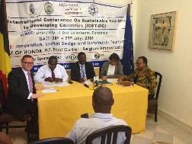
^{Our dreams}
FOR THE SOUTH
To develop the ACS as a ‘game changer’ in ARU and Dar (impact) and Africa
To build up a network in…
  Tanzania (Mzumbé, Mbeya,…)
  IUC-partner countries, Uganda, Kenia, DR Congo
  East-Africa, South-Africa

Slide 16
FOR THE NORTH
Research: knowledge centre and network of partners in sustainable urban development (interdisciplinarity)
Education
  Masters sustainable urban development
  IUC/ACS as a frame for international projects
Societal outreach in Belgium (Flanders)

Slide 17

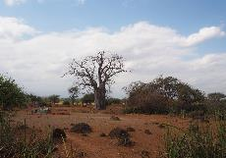

Rob Cuyvers – rob.cuyvers@uhasselt.be
Gabriel Kassenga – kassengagr@gmail.com
https://sites.google.com/uhasselt.be/iuc-aru

